Slide 1



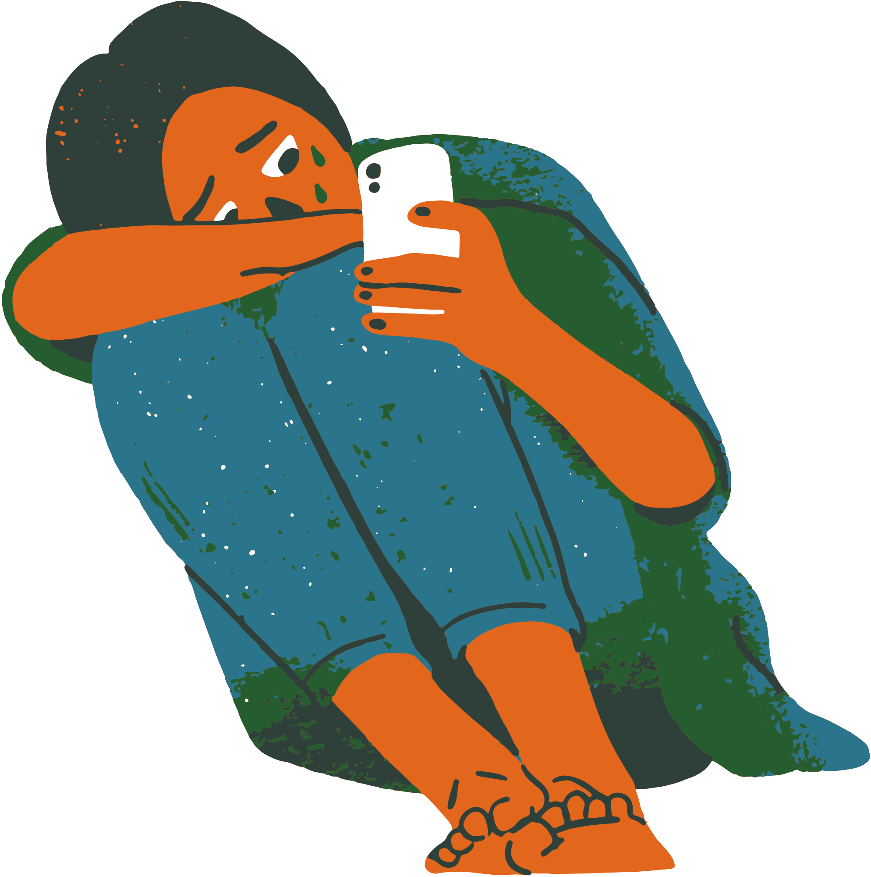

Impact of
Social
to
Mental Health

Slide 2
We get to live in a time that we get to use social media as a tool.
-Aaron Loeb

Slide 3

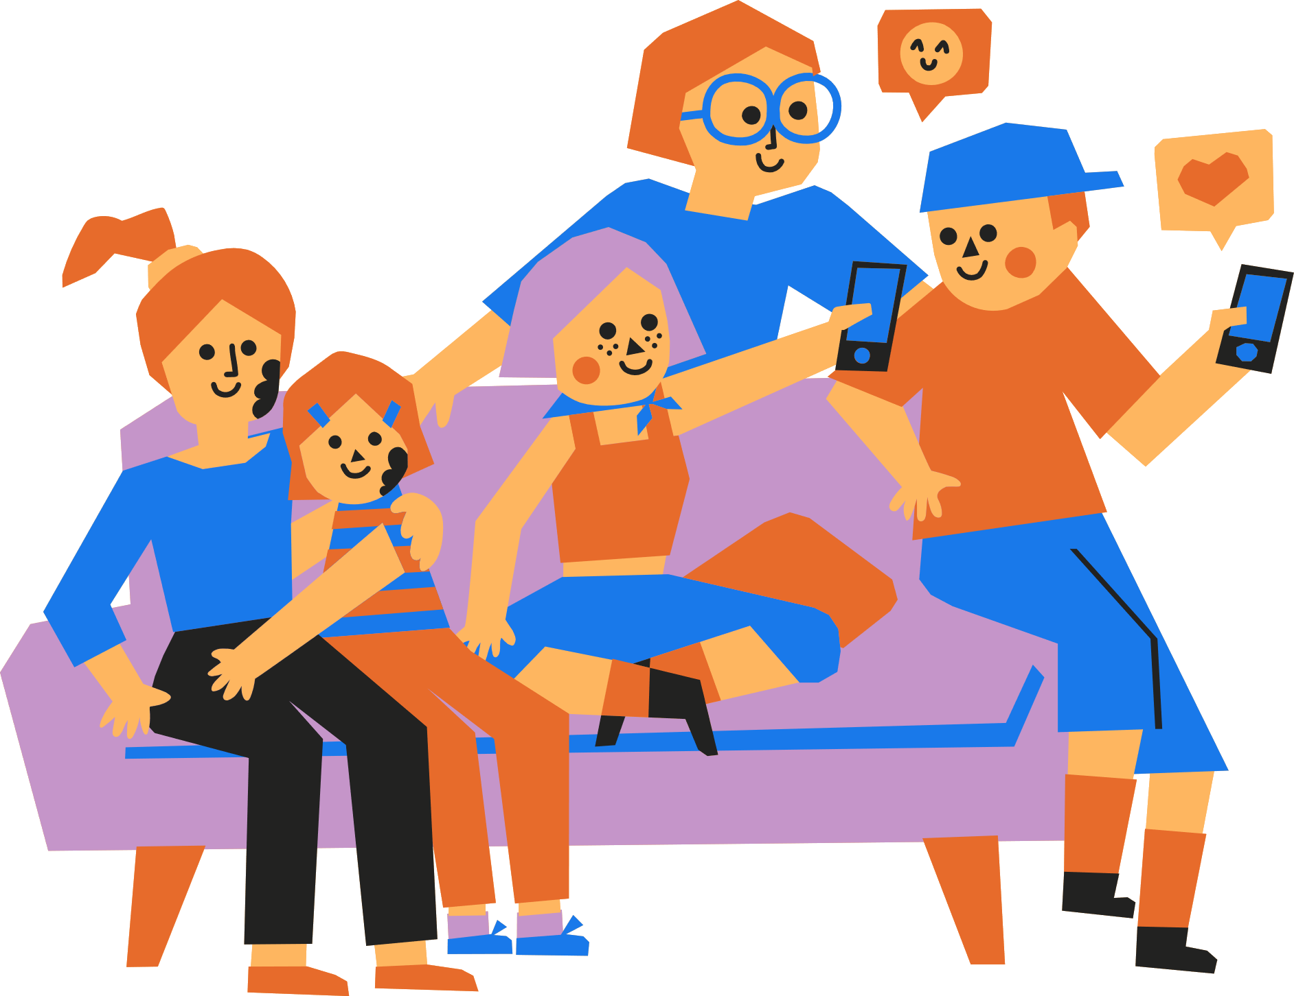

Positive Aspect of Social Media
01
Communication
03
Promote Causes
Here you can explain the topic of the section.
Here you can explain the topic of the section.
02
Friendship
Here you can explain the topic of the section.
Notes:
https://www.slideshare.net/HelenTrigueiro1/the-impact-of-social-media-on-our-mental-healthpdf

Slide 4

Item 1
15.4%
Cyberbullying
You can enter a subtitle here if you need it
Item 2
15.4%
Item 3
69.2%

